Slide 1


Water Temperature Case Study
UNCLASSIFIED
Isaac Mudge, MS
U.S. Army Corps of Engineers, New Orleans District
U.S. Army Engineer Research and Development Center, Environmental Laboratory
CE-QUAL-W2 Workshop
August 16 - 18, 2022
Environmental Systems
Modeling Team
UNCLASSIFIED

Slide 2
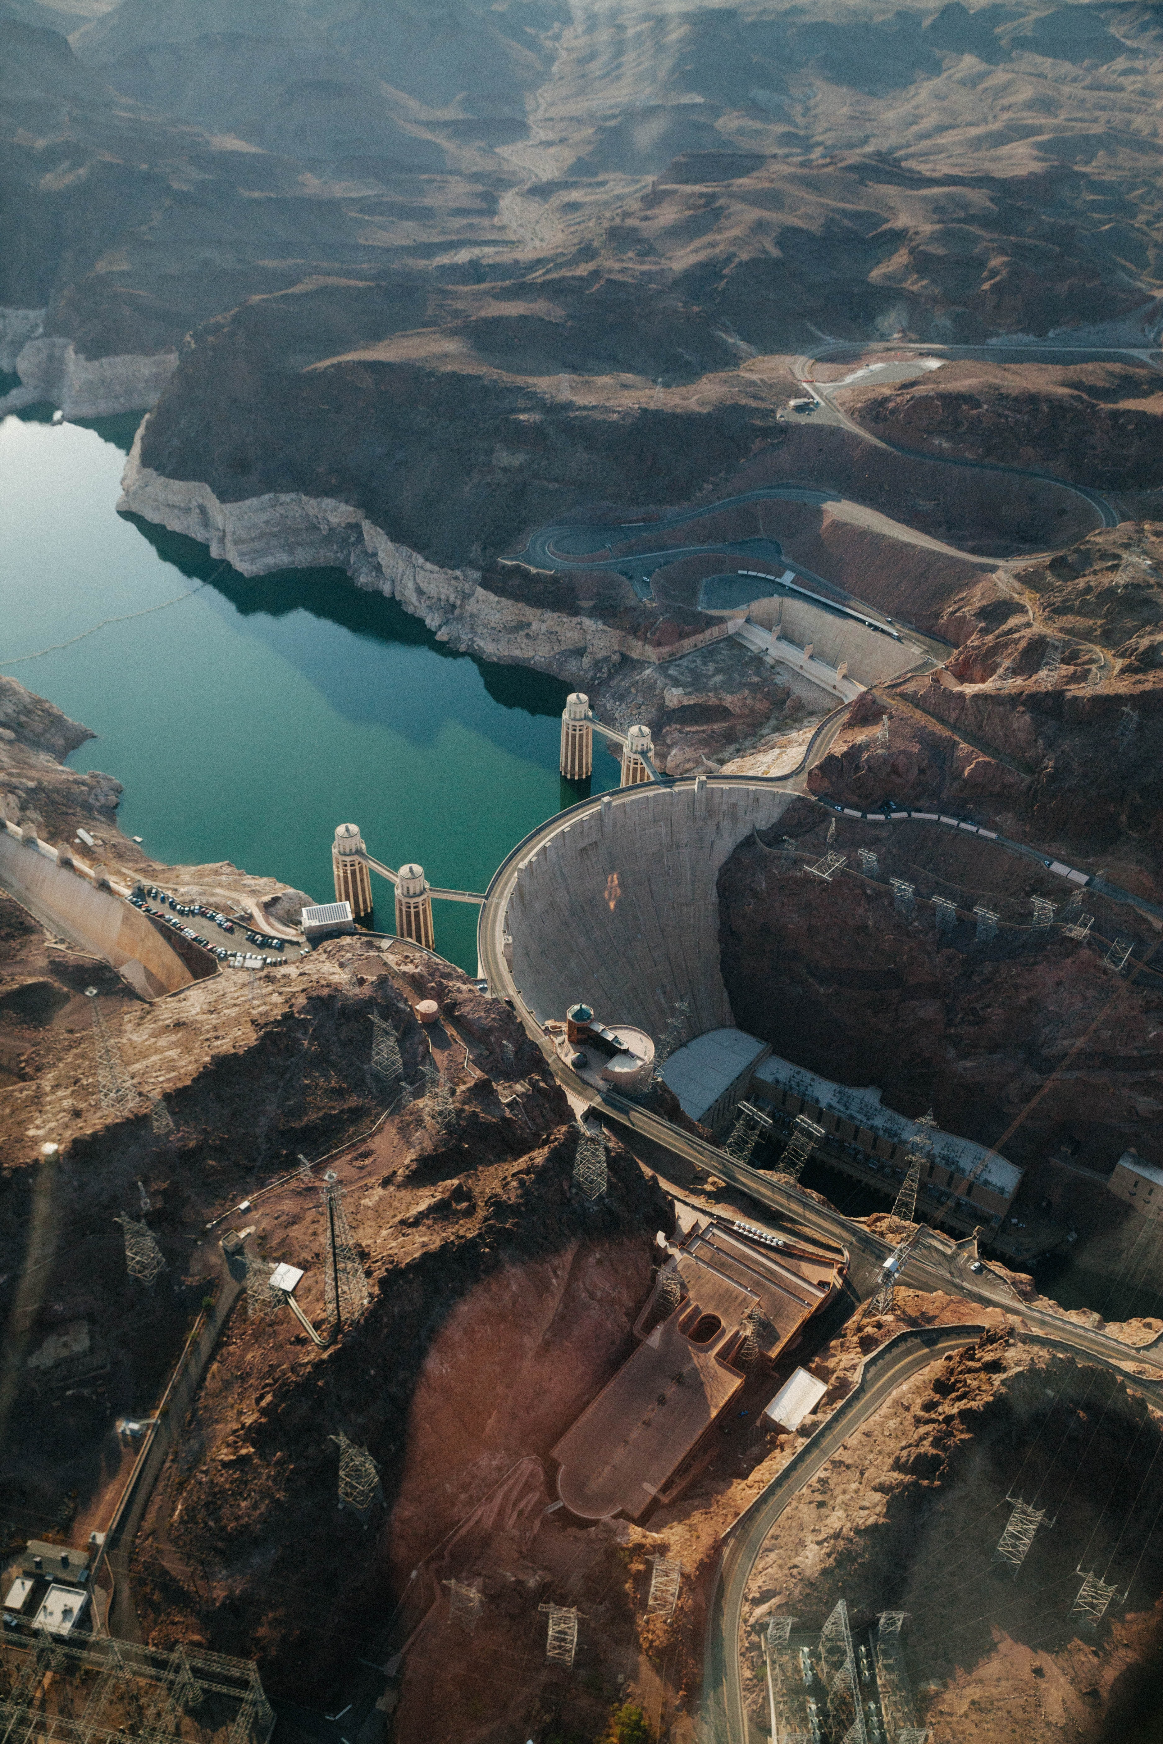
Case Study Overview
We will offer a 15-minute case study demonstration, which will walk through the model files
Participants will become familiar with the location of temperature inputs and outputs in CE-QUAL-W2.
We will focus on where temperature-related parameters appear in the control file, and the input and output files associated with running a successful temperature model.
We will tie the theory section of the user-manual to the input/output section of the user-manual.
This will be followed by a case-study where water quality parameters are changed, and output is analyzed.

Slide 3

Start with an existing model
We will use the DeGray Reservoir model, which is available automatically in the CE-QUAL-W2 download. It is currently set up to model sediment-diagenesis and vertical algae migration.
We will edit it until it features only the essentials for modeling temperature.
We are satisfied with the bathymetry and will not change it for this case study. It is simple, with one main waterbody and branch.

Slide 4
W2 Model Input Files
Organized by File Directory – for me, C:\Users\b2edhijm\Documents\Projects\ERDC Steiss\August 22 Tutorial\Temperature Workshop\Practice\DeGray Reservoir with sediment diagenesis and vertical algae migration2
File type | Label in Control File | File name
Control File | - | w2_con.csv
Wind sheltering | WSC FILE WSCFN | wsc.npt
Shading | SHDFN | shade.npt
Bathymetry | BTHFN | bth1.csv
Meteorological | METFN | met.npt
Branch inflow | QINFN branch inflow | qin_br1_equal.npt
 | TINFN branch temp | tin_br1.npt
 | CINFN branch conc | cin_br1.csv
 | QDTFN Distributed flow | qin_br1.npt
Spillway/Gate | QGTFN | qgt.npt
Sets many heat-flux control parameters
Wind func impacts both sensible and latent flux
Local shading – not cloud cover
Sets many heat-flux control parameters
AD equation – boundary conditions

Slide 5
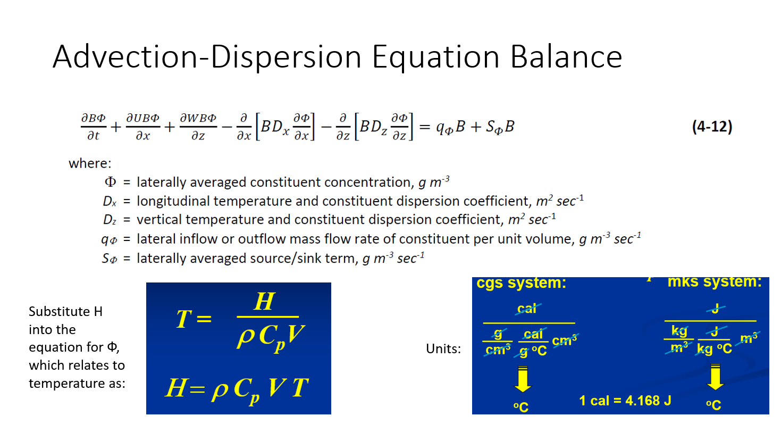
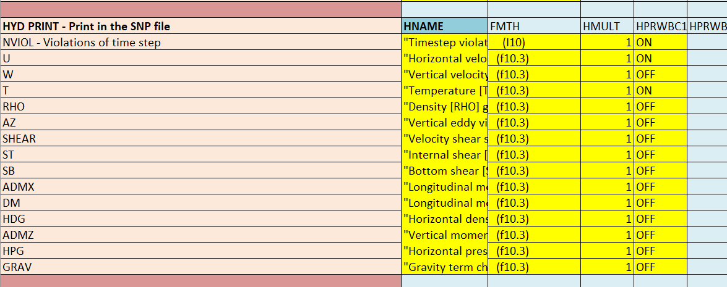
Advection Dispersion of Temp
Temperature is included in the hydraulic calculations because it affects parameters like density and viscosity, i.e., we don’t need to turn this on and off.
We will need initial and boundary conditions (BC) for this – BCs for temperature in the tin_br1.npt file

Slide 6
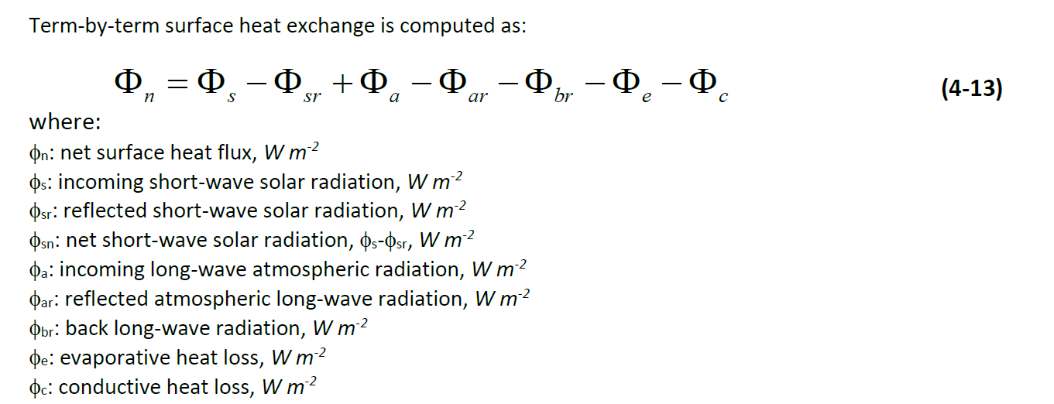
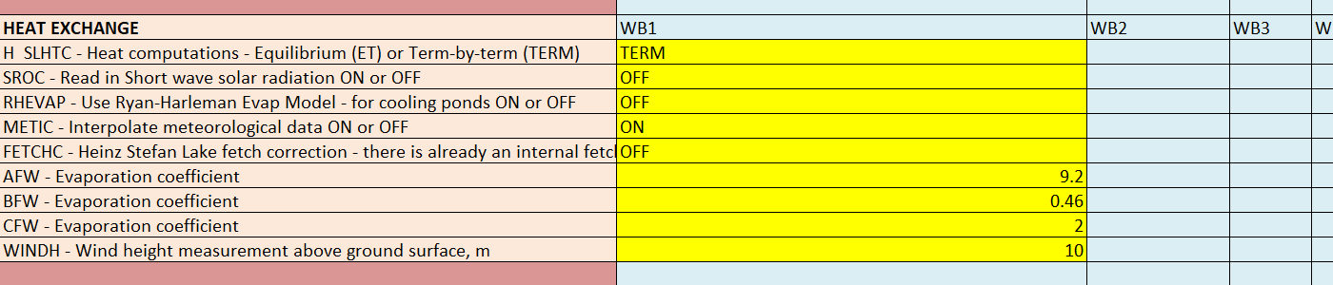
Kinetics – Equilibrium Model or Term by Term?
Sources/Sinks from manual:
Heat Exchange Parameters in .xslm interface:
EQ process is described on pages 101-102 of manual part 2.

Slide 7
Shortwave Solar Radiation
File input or computed?
It is rare to have a good short-wave solar radiation data source. Therefore, W2 uses an empirical calculation of short-wave solar radiation based on solar altitude and other parameters, as described in the user-manual, page 95-96. Many of these parameters are based on lat/long and time of day.

Slide 8
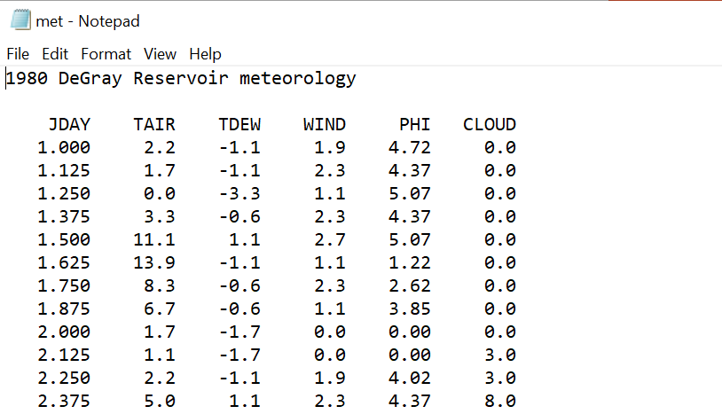
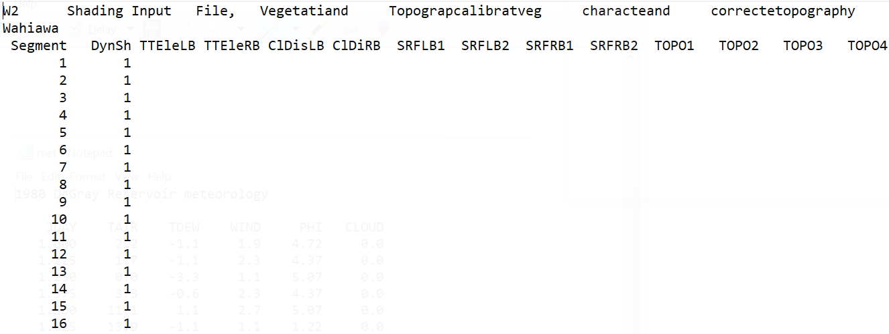
Shortwave Solar Radiation – Cloud Cover and Shade
The shortwave solar radiation is dampened by a cloud cover factor that gets defined in the meteorological file.
The shortwave solar radiation is also dampened by a local shading factor defined in the shade file.

Slide 9
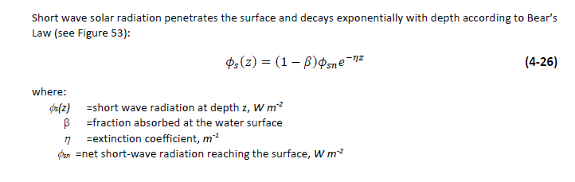
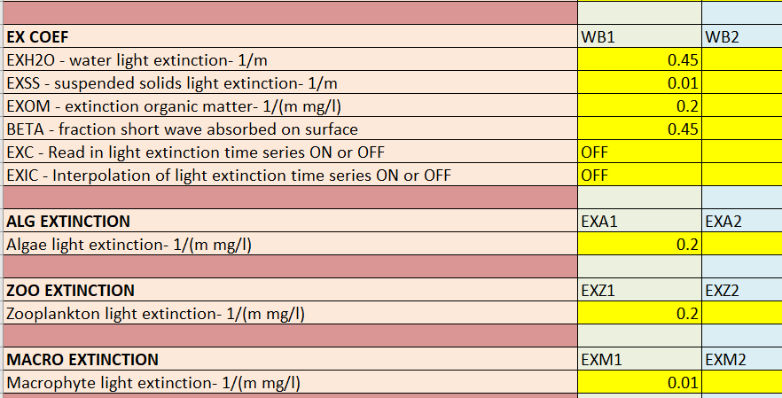
Shortwave Solar Radiation – Penetration
Theory: Every cell in the model performs this computation.
Model Input:
Extinction coefficient will be a combination of light extinction due to various constituents, such as suspended solids, algae, zooplankton, etc. Extinction will be a function of their concentrations.

Slide 10
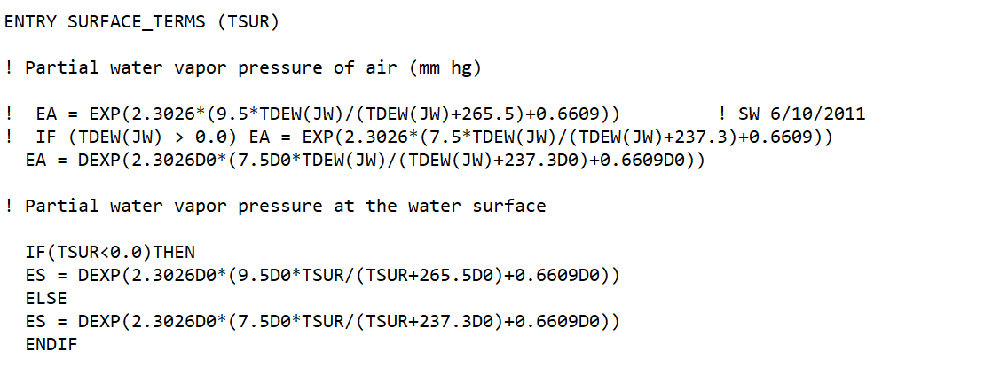
Longwave Radiation
Longwave radiation from air to water and water back to air use the same formula, based on the temperature of the emitting body, the Stephan-Boltzmann coefficient, and the emissivity of the body.
Emissivity is a function of vapor pressure, which can be calculated from the measured dew point.
Fortran source code showing how vapor pressure is calculated

Slide 11
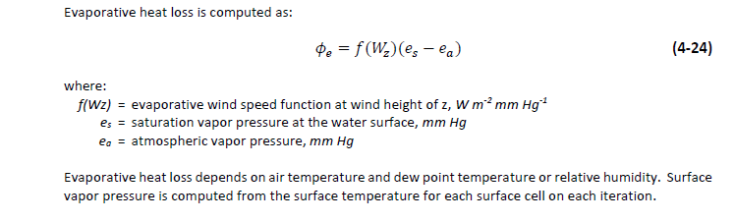
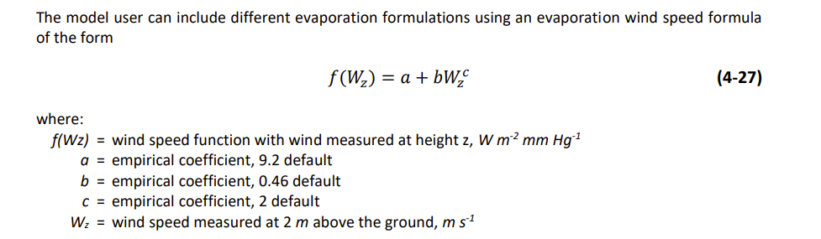
Latent Heat – Evaporation
Parameters that control evaporation are specified in the met data file and the control file.

Slide 12
Latent Heat – Evaporation
Parameters that control evaporation are specified in the met data file and the control file.

Slide 13
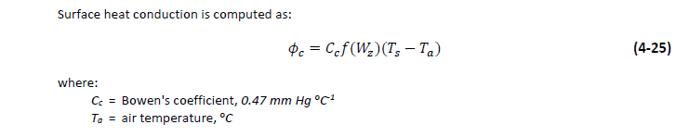
Sensible Heat – Conduction and Convection
Constant
Met file

Slide 14


Temperature Output Comparison
Model run with (1) default DeGray settings and with (2) all accessory modules and water quality calculations turned off.

Slide 15
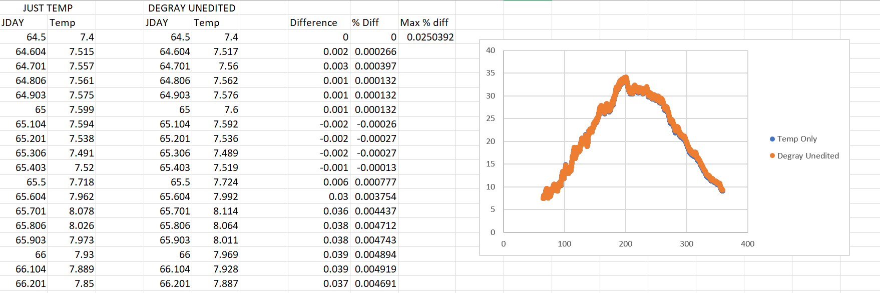
Comparison at Layer 2

Slide 16
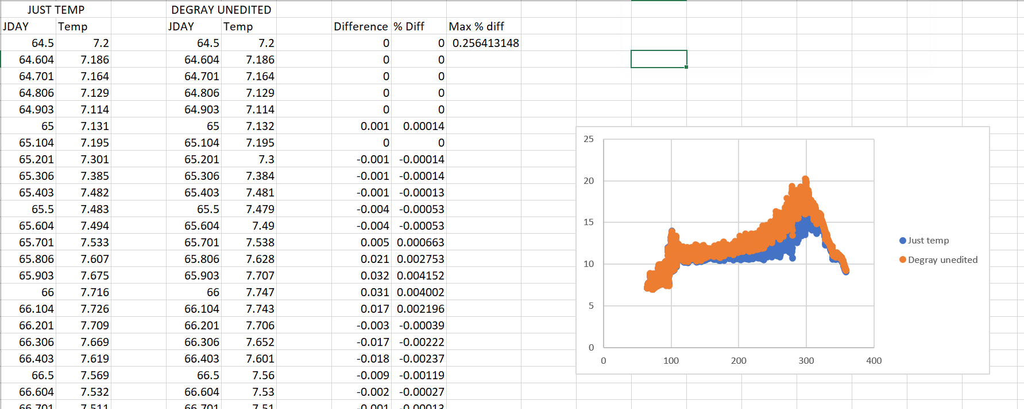
Comparison at Layer 16

Slide 17
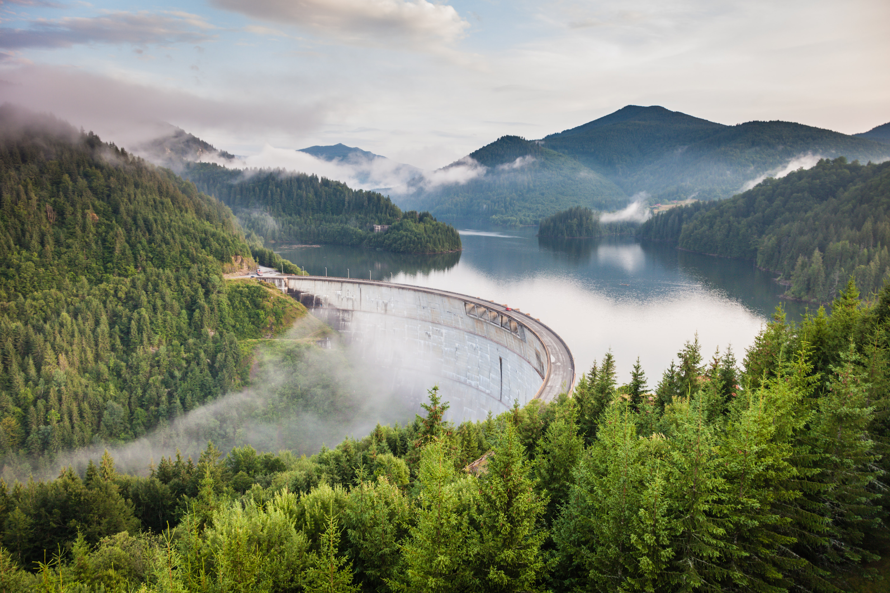
Questions?

